Slide 1

UMI OPERATIONS LAYER
From reporting to action: detect leakage, assign actions, measure recovery.
ISZE / UMI Sales Review Prototype
source: UMI Sales Review FY2027
Notes:
[Sources]
- Source deck: ISZE_UMI_Sales_Review_FY2027_ModeA_only.pptx. UMI review title and meeting context: lines 23-25.
- FY2027 YTD and budget/LY figures: lines 55-65.
- Commercial parts performance: lines 70-80.
- Category movers: lines 85-150.
- GPS, service-parts coverage, IDS and fleet/target data: lines 176-235 and 240-276.
- SPA and Sales-to-Dealer ask: lines 286-345.

Slide 2
Signal map: identify the leak before proposing the commercial answer
The problem is not one KPI; it is the relationship between fleet, capture, service and dealer execution.
Fleet
GPS
Service gaps
IDS
SPA
Data
-7.4%
54.2%
2 gaps
60.9%
pending
missing
ISZE / UMI Sales Review Prototype
source: UMI Sales Review FY2027
Notes:
[Sources]
- Source deck: ISZE_UMI_Sales_Review_FY2027_ModeA_only.pptx. UMI review title and meeting context: lines 23-25.
- FY2027 YTD and budget/LY figures: lines 55-65.
- Commercial parts performance: lines 70-80.
- Category movers: lines 85-150.
- GPS, service-parts coverage, IDS and fleet/target data: lines 176-235 and 240-276.
- SPA and Sales-to-Dealer ask: lines 286-345.

Slide 3
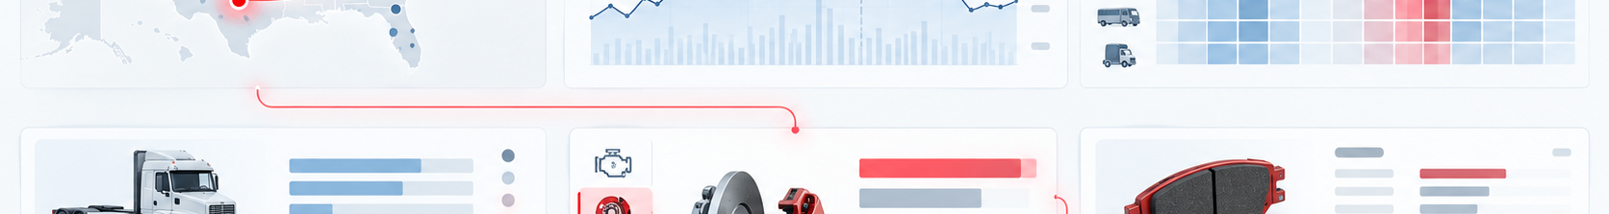
Action graph: each decision unlocks the next layer of visibility
Customer data is not a side request; it is the operating layer for SPA and target quality.
01
02
03
04
05
Part-level Sales-to-Dealer
Separate stock vs lost job
Counter SPA list
Pilot service-pack
Measure GPS lift
ISZE / UMI Sales Review Prototype
source: UMI Sales Review FY2027
Notes:
[Sources]
- Source deck: ISZE_UMI_Sales_Review_FY2027_ModeA_only.pptx. UMI review title and meeting context: lines 23-25.
- FY2027 YTD and budget/LY figures: lines 55-65.
- Commercial parts performance: lines 70-80.
- Category movers: lines 85-150.
- GPS, service-parts coverage, IDS and fleet/target data: lines 176-235 and 240-276.
- SPA and Sales-to-Dealer ask: lines 286-345.

Slide 4
Control-room ask: agree four operating decisions
This is a decision deck, not a reporting deck.
Operator actions
Next review
Close Shell price hold
weekly / monthly
status by action, not by slide
Pick first service-parts pilot
Return SPA counter-list
Owner model
ISZE + UMI
Share Sales-to-Dealer data
single owner per action
ISZE / UMI Sales Review Prototype
source: UMI Sales Review FY2027
Notes:
[Sources]
- Source deck: ISZE_UMI_Sales_Review_FY2027_ModeA_only.pptx. UMI review title and meeting context: lines 23-25.
- FY2027 YTD and budget/LY figures: lines 55-65.
- Commercial parts performance: lines 70-80.
- Category movers: lines 85-150.
- GPS, service-parts coverage, IDS and fleet/target data: lines 176-235 and 240-276.
- SPA and Sales-to-Dealer ask: lines 286-345.

